Slide 1

Chicago Crimes Dataset
Presented by Cody Taylor, Lauren Mitchek, and Faith Elrod

Slide 2
Our Problem
Understanding how temporal patterns (seasonality, day of week, weekends) and special events impact different categories of crime in Chicago from 2015-2024. Specifically, predicting daily crime counts across four categories:
Non-Violent crimes (theft, robbery, narcotics, burglary))
Violent crimes (battery, assault, criminal damage, homicide)
Human Trafficking/Sex crimes
Total crime counts

Slide 3
Background
Key Variables:
Temporal factors: Day of week, month, season, weekend vs. weekday
Special events: Chicago Marathon, Lollapalooza, river events, and other special events
Crime categories: Classified into non-violent, violent, special event, and human trafficking/sex crimes

Slide 4
Objectives and Data Sources
Data Sources:
  chicago_crime_2001_2025.parquet
  Calendar for special events and federal holidays
Objectives:
  Quantify the relationship between temporal predictors and crime counts across multiple crime categories
  Identify statistically significant patterns in crime occurrence by the day of the week, month, season, and special events
  Develop predictive models capable of forecasting daily crime counts with reasonable accuracy
  Compare crime patterns between violent, non-violent, human trafficking/ sex crimes, and special event-related crimes

Slide 5
How we obtained the objectives
  Aggregate outcomes at the daily level instead of month, day, year, hour, minute, second
  Group outcomes into non-violent, violent, and human trafficking/ sex crime variables
  Include data from 2015 to 2024
  Conduct an 80/20 Train/Test Split
  Train models on outcome counts
  Measure Accuracy using RSME
  Use RMSE and Deviance explained to see if there is a significant difference
  Use the predictors of day of the week, weekend, month, season, and special event

Slide 6
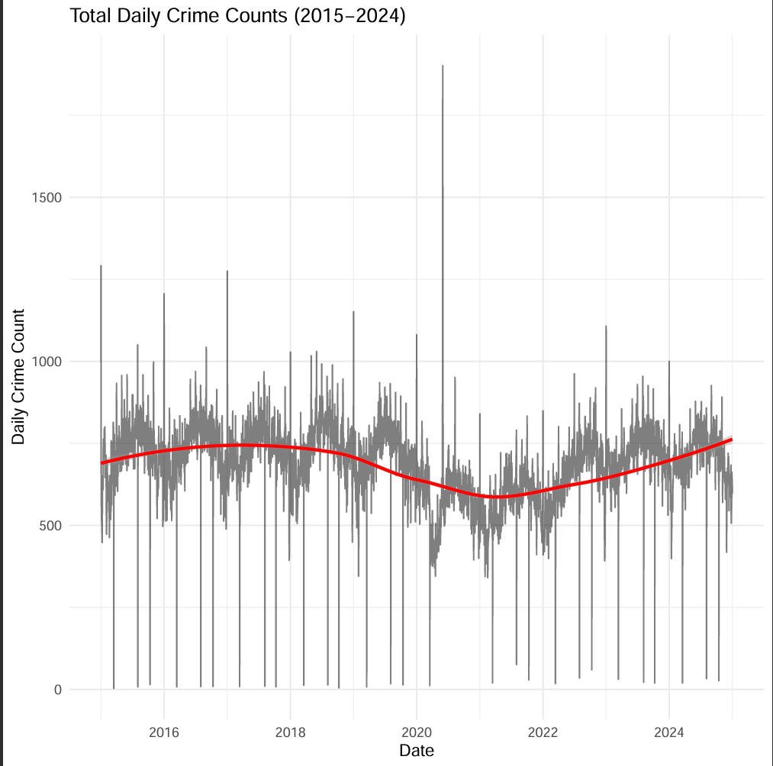
Crime Trends Over Time
Overall crime has declined by approximately 45% over the study period
Strong seasonal patterns persist
Red smoothing line shows general yearly trend
This trend justifies temporal analysis to understand cyclical patterns

Slide 7
Model Specification
We are modeling count data, therefore a Poisson regression is appropriate.
Initial investigation yields a dispersion factor of 14.4, indicating significant overdispersion.
Thus, we will implement a negative binomial regression for predicting daily counts of crime data.

Slide 8
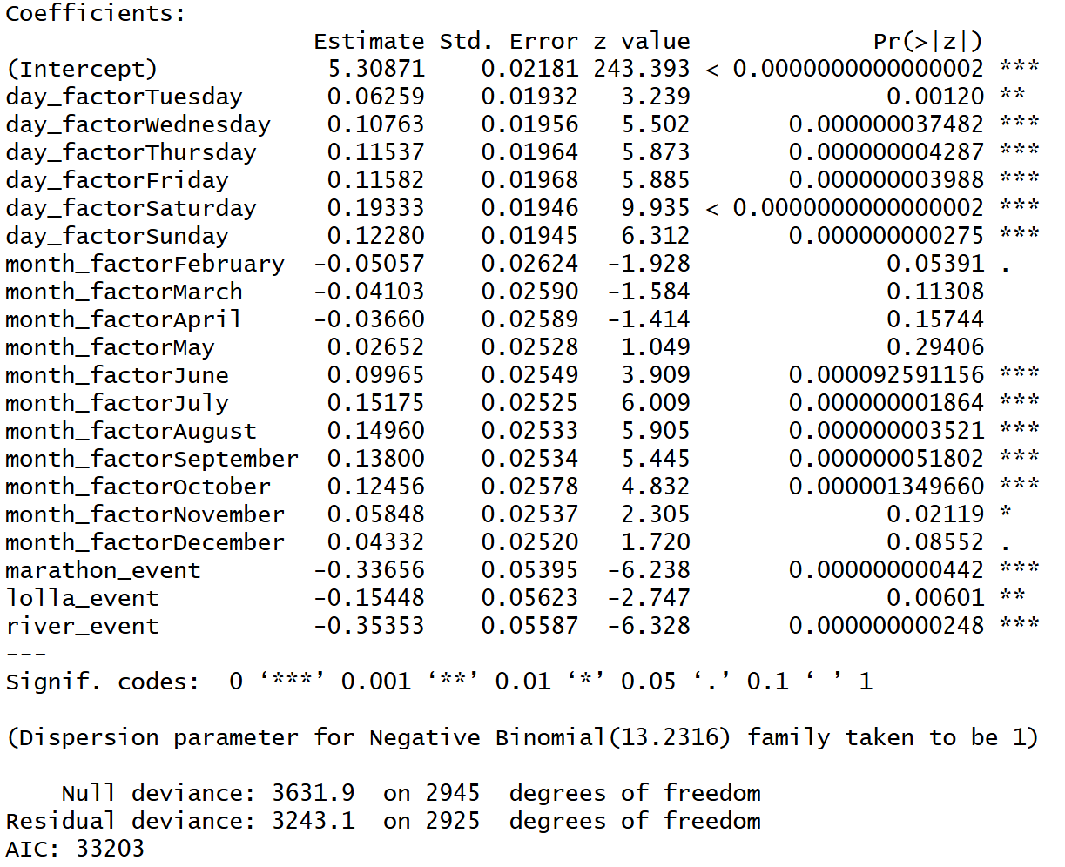
Model Selection: Non-violent crime
Training Pipeline
Stepwise AIC selection
All predictors were kept
Only explained ~11% of the deviance in the data
This is what we called the "detailed" model

Slide 9
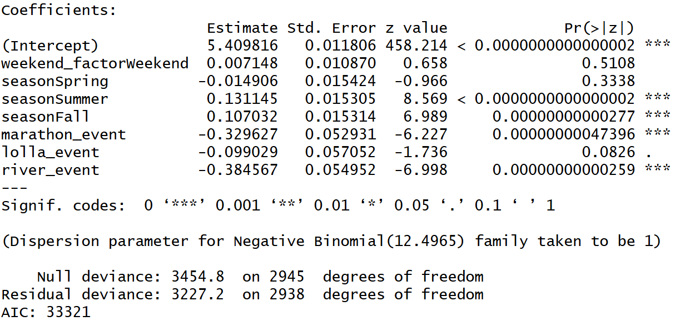
Model Selection: Non-violent crime
Training Pipeline
This is the full model aggregated at the weekend and season level
Only explained ~7% of the deviance in the data
This is what we called the "simple" model

Slide 10
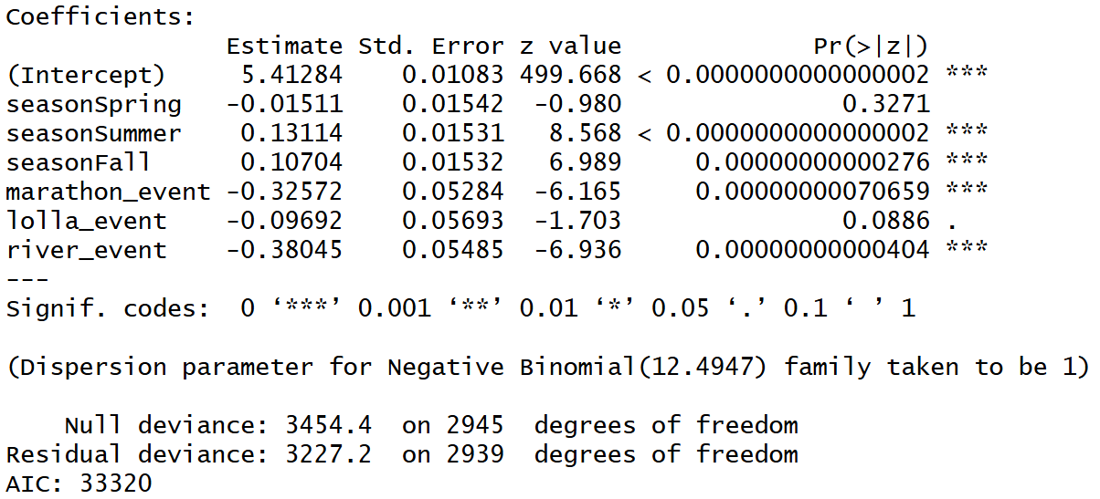
Model Selection: Non-violent crime
Training Pipeline
After AIC stepwise selection weekend was eliminated
Still explained ~7% of the deviance in the data

Slide 11
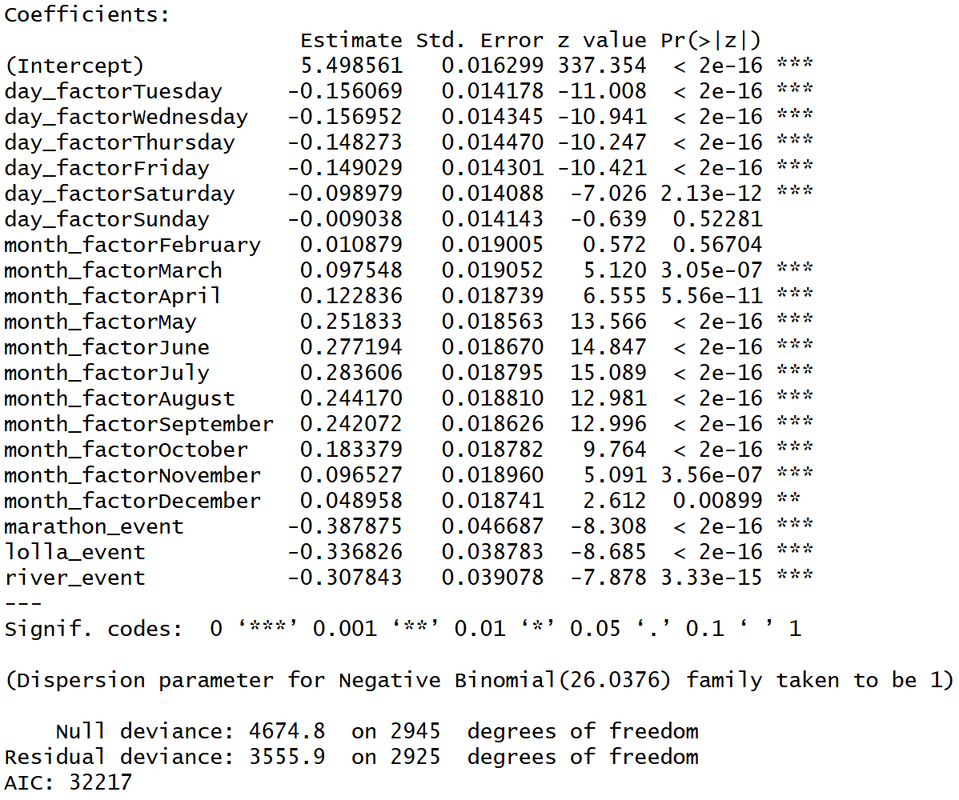
Model Selection: Violent crime
Training Pipeline
Stepwise AIC selection
All predictors were kept
Only explained ~24% of the deviance in the data
This is what we called the "detailed" model

Slide 12
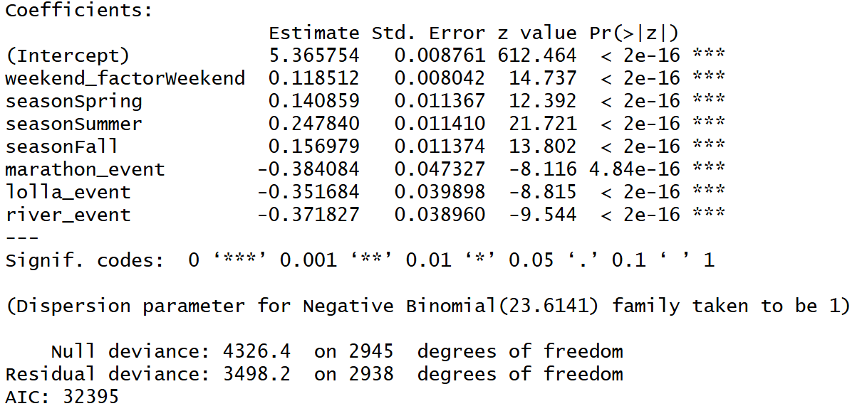
Model Selection: Violent crime
Training Pipeline
Stepwise AIC selection
All predictors were kept
Only explained ~20% of the deviance in the data
This is what we called the "simple" model

Slide 13
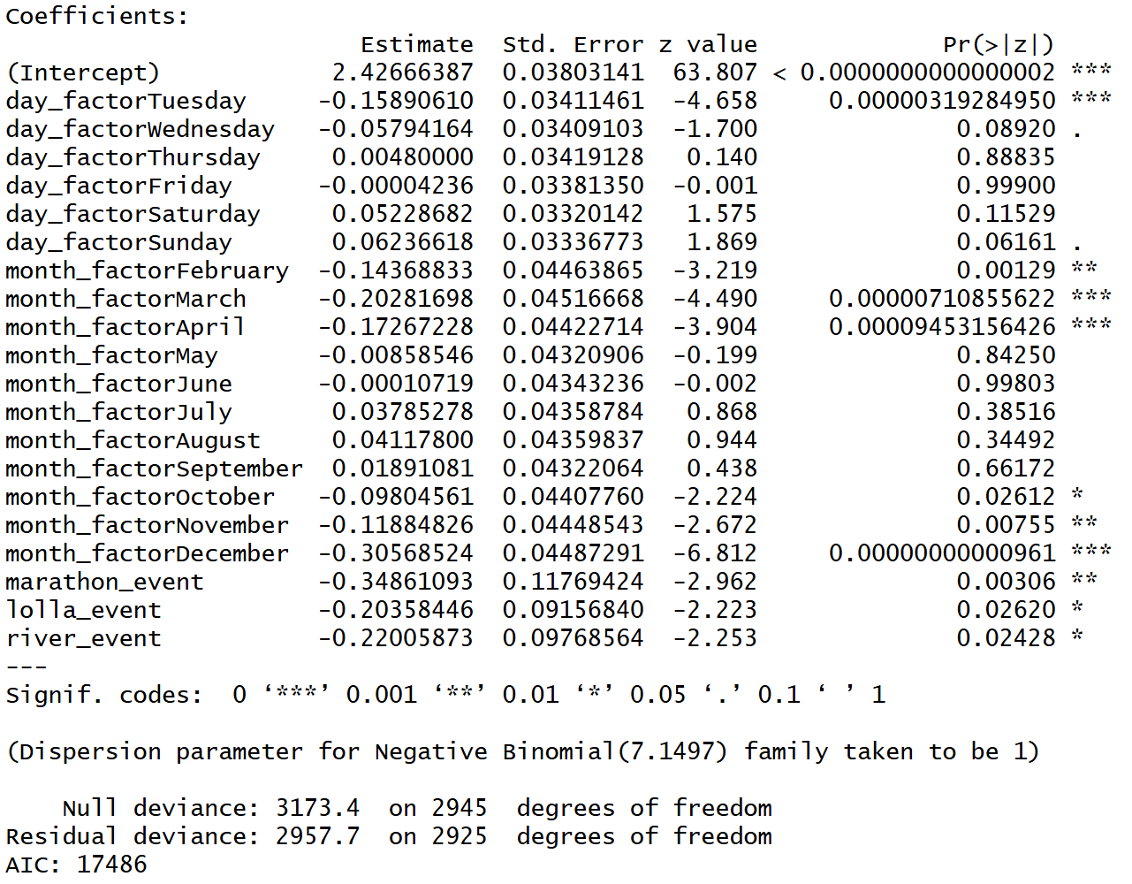
Model Selection: Trafficking crime
Training Pipeline
Stepwise AIC selection
All predictors were kept
Explained ~7% of the deviance in the data
This is what we called the "detailed" model

Slide 14
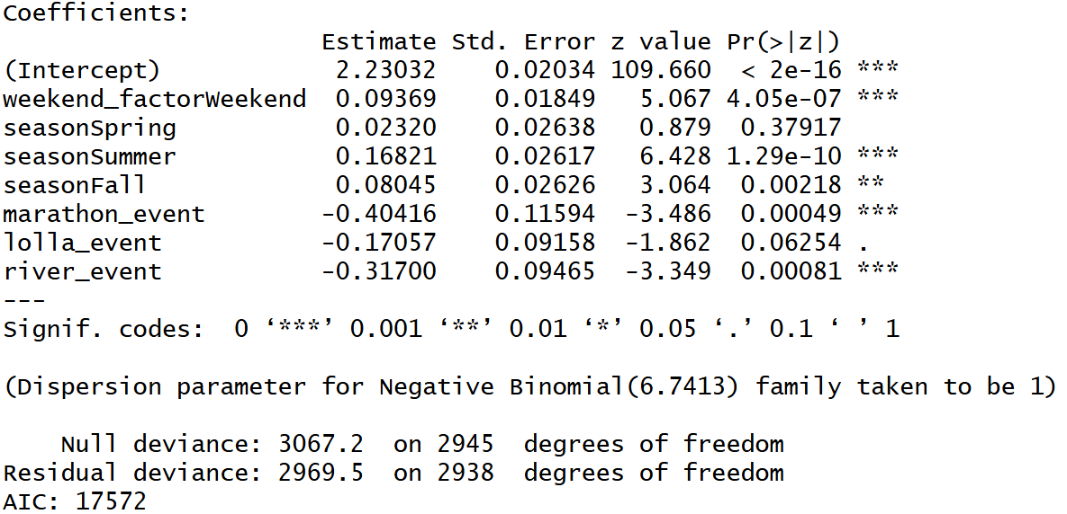
Model Selection: Trafficking crime
Training Pipeline
Stepwise AIC selection
All predictors were kept
Only explained ~3% of the deviance in the data
This is what we called the "simple" model

Slide 15
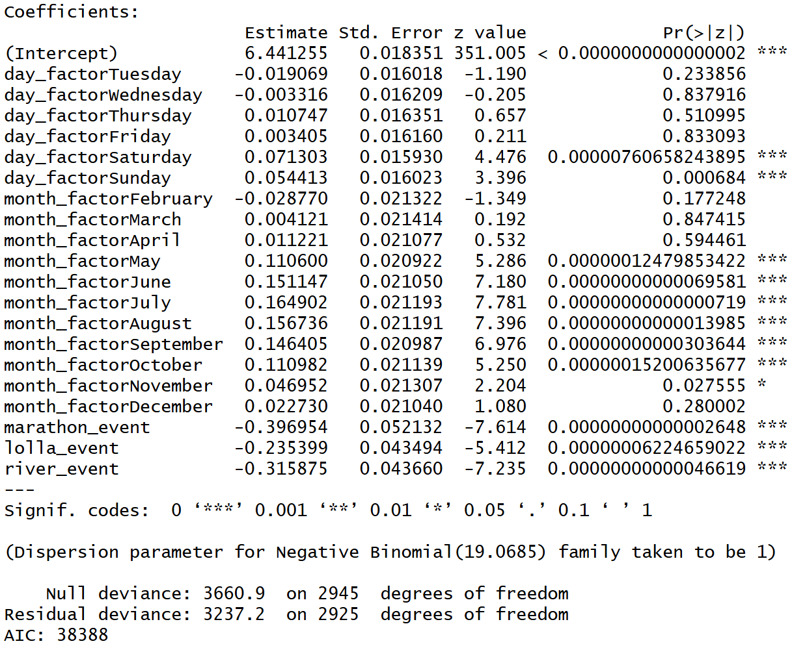
Model Selection: Total crime
Training Pipeline
Stepwise AIC selection
All predictors were kept
Only explained ~11.5% of the deviance in the data
This is what we called the "detailed" model

Slide 16
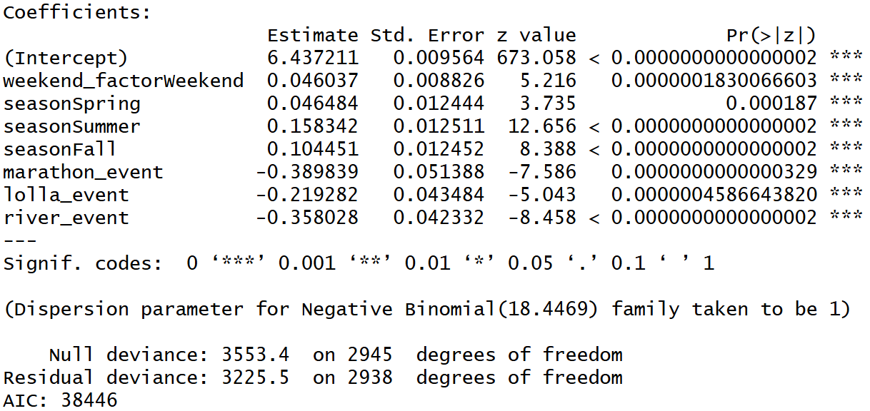
Model Selection: Total crime
Training Pipeline
Stepwise AIC selection
All predictors were kept
Only explained ~9% of the deviance in the data
This is what we called the "simple" model

Slide 17
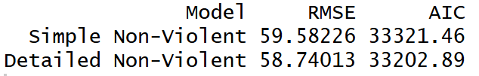

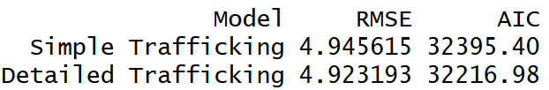

Model Selection
Testing Set Comparison
Similar RMSE's between simple and detailed models
Violent crime seems to benefit the most from including detailed day and month variables

Slide 18
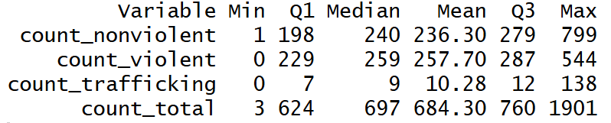
Model Selection

Slide 19
Example: Total Crime Model Interpretation
Coefficients:
An intercept of 6.44 needs to be exponentiated
Intercept is 620
That equates to baseline (Monday, January, no special event)
Predictors are multiplicative (Saturday has a 7.4% higher average count than Monday)

Slide 20
Key Results and Insights
Three negative binomial models showed reasonably good fit:
Non-Violent Crime (Detailed): RMSE = 58.74, Mean = 236, 11% DE
Violent Crime (Detailed): RMSE = 37.33, Mean = 358, 24% DE
Total Crime (Detailed): RMSE = 102.37, Mean = 684, 11.5% DE
And one showed poor fit:
Trafficking/Sex Crime (Simple): RMSE = 4.95, Mean = 10.28, 3% DE
*DE means Deviance Explained

Slide 21
Patterns Discovered
Day of Week Effects:
Non-violent crimes: Peak on Saturdays (+21.3%, p < 0.001), followed by Sundays (+13.1%)
Violent crimes: Peak on Mondays/Sundays (weekends), significant decrease Tuesday-Thursday (-13.5%, p < 0.001)
Monthly/Seasonal Effects: Summer months (June-August) show highest crime counts across all categories
Non-violent crimes: Peak in July/August (+14-16%, p < 0.001 vs January)
Violent crimes: Strong summer surge - May through September
(+27-33%, p< 0.001)
June shows +16.3% increase compared to January for total crimes
Trafficking/Sex crimes: Lower in winter months (February-March, November-December show –11.3% to –26.3%, p < 0.001)

Slide 22
Special Event Impact
Significant Findings:
General special events: Associated with a drop in total crime between 25% and 48% (p<0.001)
  Likely due to increased police presence and street closures
Lollapalooza festival: Associated with the weakest decrease in crime among special events (~20%-30%)
  Consistent with large crowds, tourist activity, and opportunity crimes
Multiplicative effect: These events showed a significant difference from normal when controlling for season, month, day, and weekend vs. weekday

Slide 23
Key Discoveries
1. Clear seasonality exists: Summer months consistently show 20-30% higher crime rates than winter
2. Weekend patterns differ by crime type: Violent crimes spike on weekends, while non-violent crimes peak on Saturdays specifically
3. Event policing works: Special events reduce crime, likely through resource deployment

Slide 24
Recommendations
Increase police staffing during summer months due to crime peaks in summer
  Impact: Better coverage during high crime periods
Maintain higher weekend staffing due to increased crimes on weekends
  Impact: Reduced criminal activity
Continue existing policies during special events
  Impact: Maintain public safety during high traffic events
Launch crime prevention initiatives during the summer
  Impact: Reduce crime in the summer and allow for positive alternatives to crime

Slide 25
Discussion of potential limitations
Limitations:
  Not all crimes reported due to stigma and fear regarding sexual assault and domestic violence
    Findings represent reported crime patterns not total criminal activity
  Data errors in crime type classification, date/time accuracy, location coding, and data entry
    May blur the distinctions between crime categories
  Crime classification system changes over the 10-year period
    Some trends could reflect changes in reporting procedures, legal definitions, and data collection methods
    For example, human trafficking became a more recognized crime category recently

Slide 26
Discussion of potential limitations
Limitations:
  Daily aggregation loses within hour-of-day effects
    Cannot assess late-night patterns, rush hour, morning crimes, etc.
  Cannot establish causes only association
    Summer has more crime however we cannot prove that weather causes crime
      Could be kids are not in school whereas they are in school in Aug-May
    Holidays and special events have lower crime
      Could be increased preparedness during high visibility events
    Weekends have higher crime rate
      Could be kids are not in school as well as alcohol availability or even work schedules

Slide 27
Discussion of assumptions
Assumptions:
  Crime reports accurately reflect criminal activity
    Classification errors are random
  Daily aggregation preserves meaningful patterns
    Hour to hour variation is less important than day to day
    Daily counts capture relevant information
  Crime categories are mutually exclusive
    Classification system cleanly separates crime types
  No major policy shifts altering crime dynamics and classifications

Slide 28
Questions

